Slide 1
NASA Asteroid Data Analysis
CS 5525 Cloud Computing Project
Team Members:
Sindhusha Tiyyagura
Pradeepika Kolluru

Slide 2
Objective
The main objective of our project is to analyse NASA Asteroid space data and to display the data in more sophisticated ways such as dashboards, space view along with objects, line graphs, and bar graphs.
Notes:
NASA provides data for various things, from weather and climate to solar flares and wildfire.

Slide 3
Motivation
A data analysis and visualization graph helps to
Find out data patterns
Predict the impact of future object based on their size and velocity.
Can understand the data properly
Figure data outliers

Slide 4
Type of project:
Technologies used
Real time data (dynamic) using NASA NEO API
Angular 7 for creating web pages.
Open source visualization tools.
Github for tracking source code
Python and pycharm for developing models
Visualization and development

Slide 5
NASA Asteroids API(NeoWs)
Gathering the real time asteroids data using NASA Neo API:
Can get details of all asteroids ( Complete )
Can get the details of particular asteroid ( Lookup )
Can get the details for a specific time period ( Search )
Data-set URL: http://neo.jpl.nasa.gov/

Slide 6
NASA NEO API
The data set gives the following data about the asteroid:
1) Size of the object => Diameter ( in meters )
2) Velocity (speed) of the object => Velocity ( in km/s)
3) Orbital data of the object (journey/path of the object).
4) Miss distance of the object to the earth => Close Approach Distance (CA) either in Lunar Distance or au(astronomical unit)

Slide 7
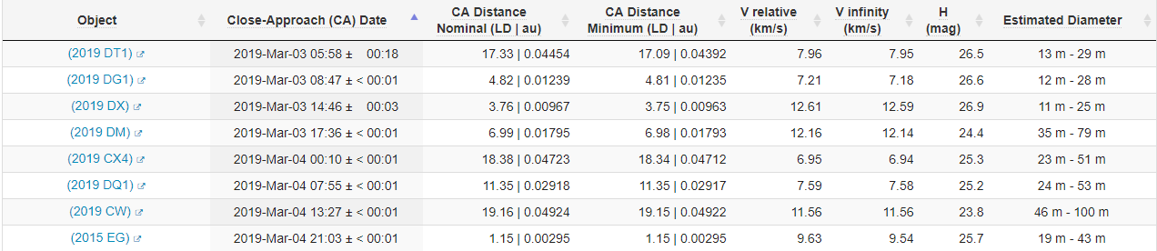
NASA NEO API

Slide 8
Objective for Mid Progress
Task-1: Showing the list of all asteroids for past one week.
Operations that can be done:
User can view list of all asteroids in a table with fields like name, closest approach date, potentially hazardous for earth, size of asteroid ( radius ) , velocity relative to the earth, miss distance with earth.
User can search for any asteroid based on any field ( filter on any field ).
Notes:
Main goal was to the visualize the json data values in a good format

Slide 9
Objective for Mid Progress
Task-2: Plotting a dot graph of all asteroids listed in last one week.
1) User can compare how the miss distance from earth and velocity could effect the hazardous of asteroid to earth.

Slide 10
Objective for Mid Progress
Task-3: Showing Space view of all asteroids listed in past one week.
User can view total number of asteroids count that are appeared in last one week.
User can view the {Furthest, smallest, closest, fastest, slowest, Biggest} asteroids to the earth.
User can get information for any time period.

Slide 11
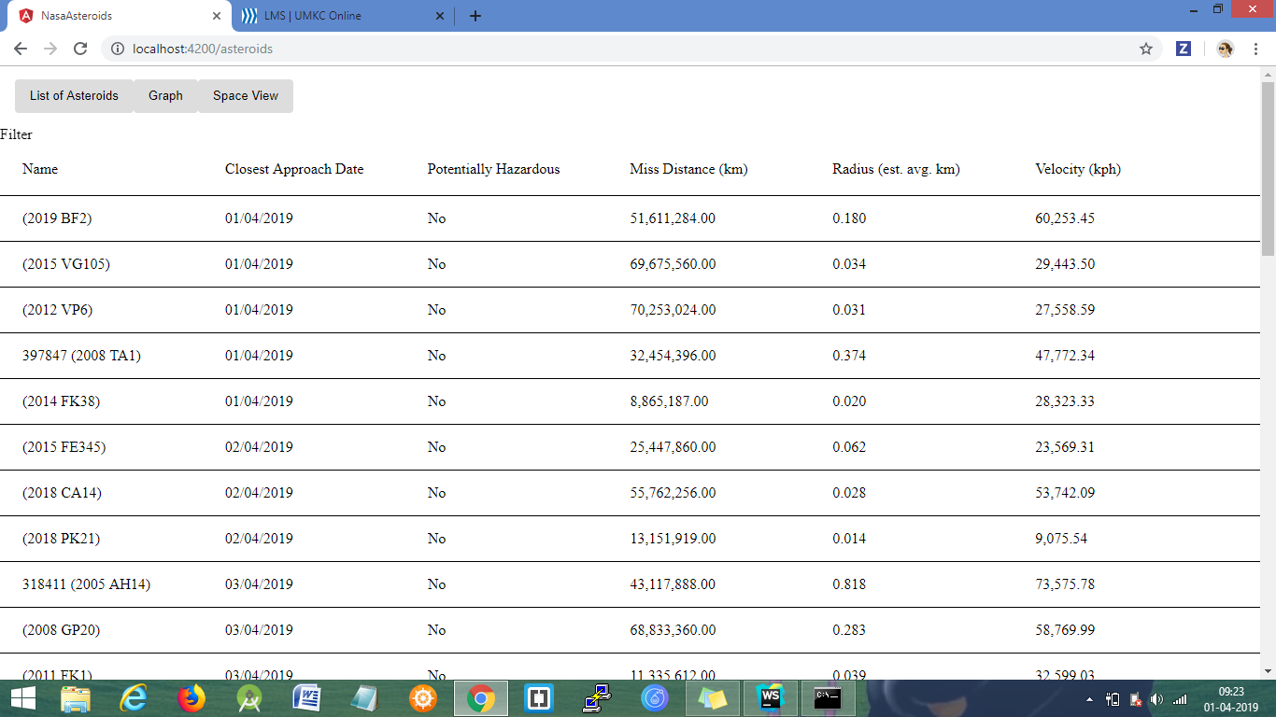
Task-1: Home page

Slide 12
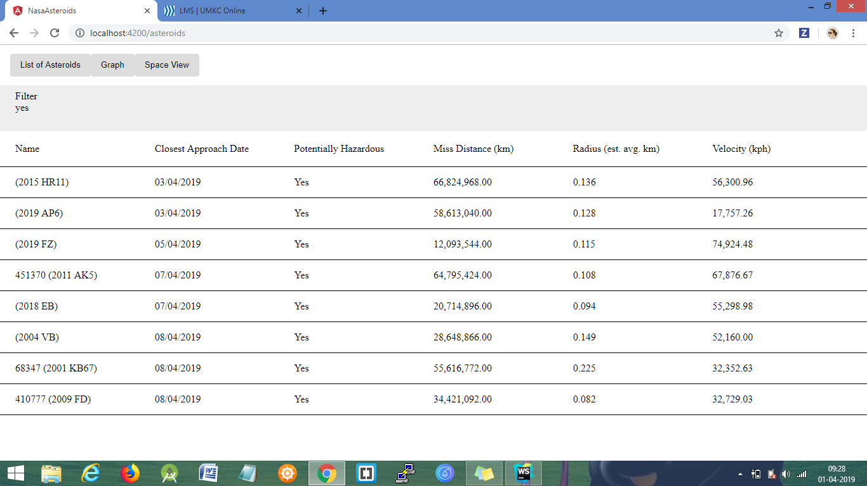
Task-1: Home page with filters

Slide 13
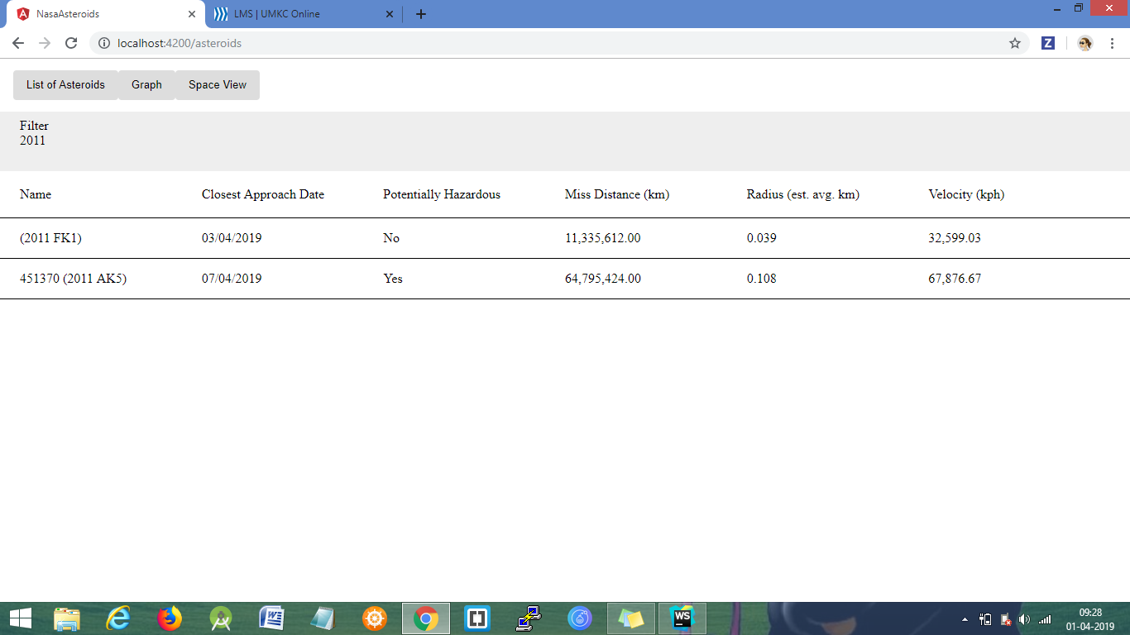
Task-1: Home page with filters

Slide 14
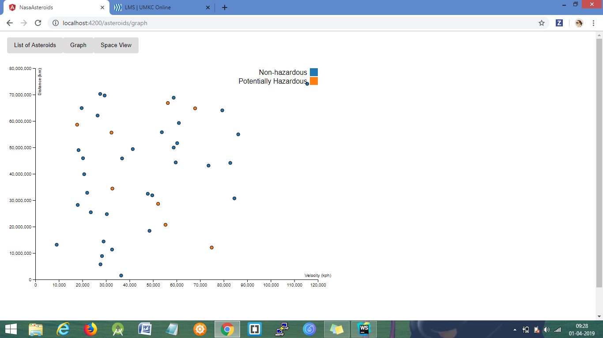
Task-2: Graph

Slide 15
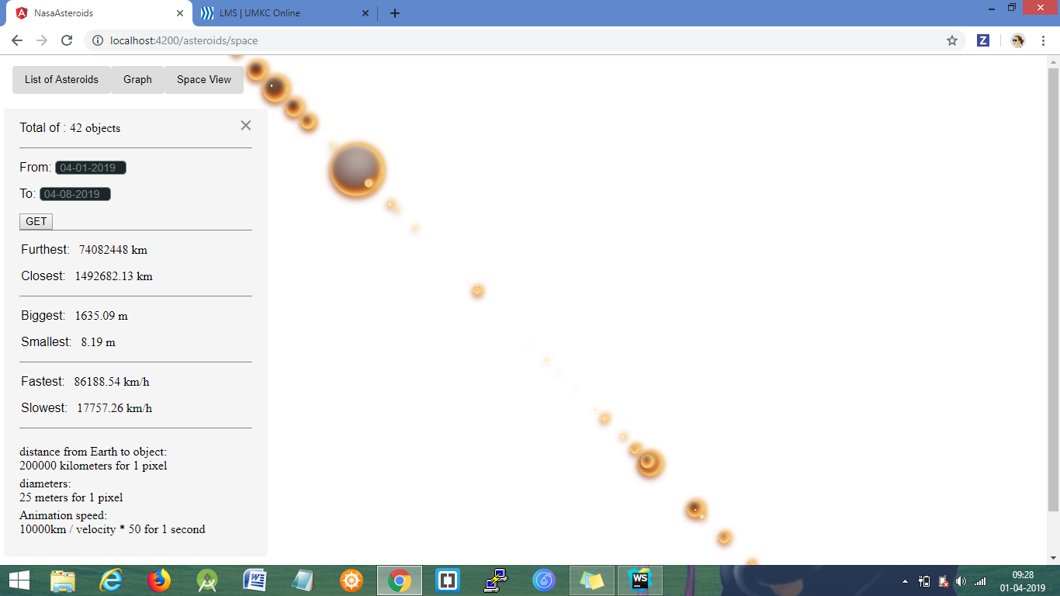
Task-3: Space View

Slide 16
Thank you

